Slide 1
A mutli-agent adaptive deep learning framework for online intrusion detection
Guided by:
DR. K S Angel Viji
Associate Professor
Department Of Computer Science
Presented by:
Vishnu R Pillai
PRN21CS099 Group 7

Slide 2
ABSTRACT
IDS are critical security tools designed to monitor network traffic for signs of malicious activity, identifying potential threats and distinguishing between normal and harmful behavior to protect systems from attacks.
DL-based IDS automates feature extraction, aiming to reduce time-consuming manual processes, yet faces challenges in real-world deployment.
A major issue where network behavior evolves due to zero-day attacks and changing user/application patterns, impacting IDS effectiveness.
A novel multi-agent DL-based IDS framework is introduced, featuring continual learning for concept drift adaptation and federated learning for knowledge sharing across agents.

Slide 3
CONTENTS
INTRODUCTION
LITERATURE SURVEY
METHODOLOGY
RESULTS
CONCLUSION
REFERENCES

Slide 4
INTRODUCTION
The cyber threat landscape is becoming more sophisticated, with attackers constantly finding new vulnerabilities and launching advanced, unpredictable attacks.
Traditional security measures, like signature-based Intrusion Detection Systems (IDSes), rely on predefined patterns of known threats, which leaves systems vulnerable to zero-day attacks and unknown threats.
Limitations:- Static Detection, Slow Response, Inability to Adapt(Concept drift)
Deep Learning (DL) has proven effective in various domains, including cybersecurity, by automatically learning complex patterns from data.
DL-based IDSes have the potential to detect new types of attacks without needing human-defined signatures, enabling faster and more adaptive detection of threats.

Slide 5
INTRODUCTION (Contd.)
A federated learning approach allows agents to share knowledge, enhancing detection accuracy and adaptability.
By using continual learning, the framework adapts to evolving traffic and threats, providing a more secure network environment.
The framework aims to address the shortcomings of traditional and DL-based IDSes by introducing a distributed, real-time, and adaptable solution to handle evolving traffic and new threats.

Slide 6
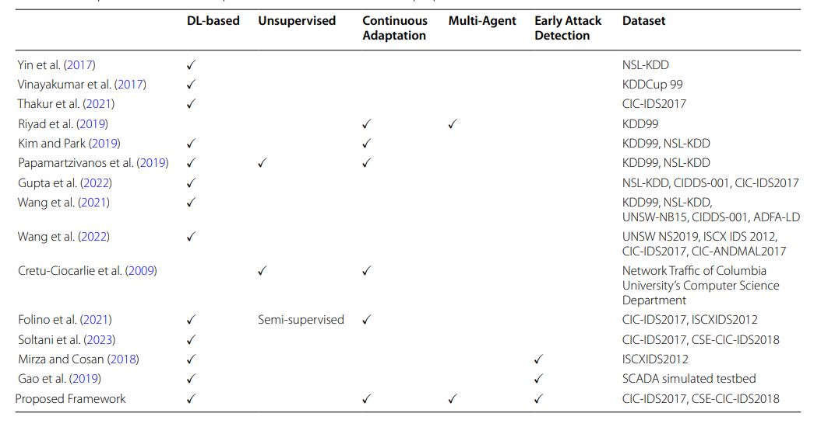
COMPARISION BETWEEN PREVIOUS STUDIES AND THE PROPOSED FRAMEWORK

Slide 7
METHODOLOGY
Framework Overview
Data Collection and Preprocessing
Architecture
Model Training and Evaluation

Slide 8
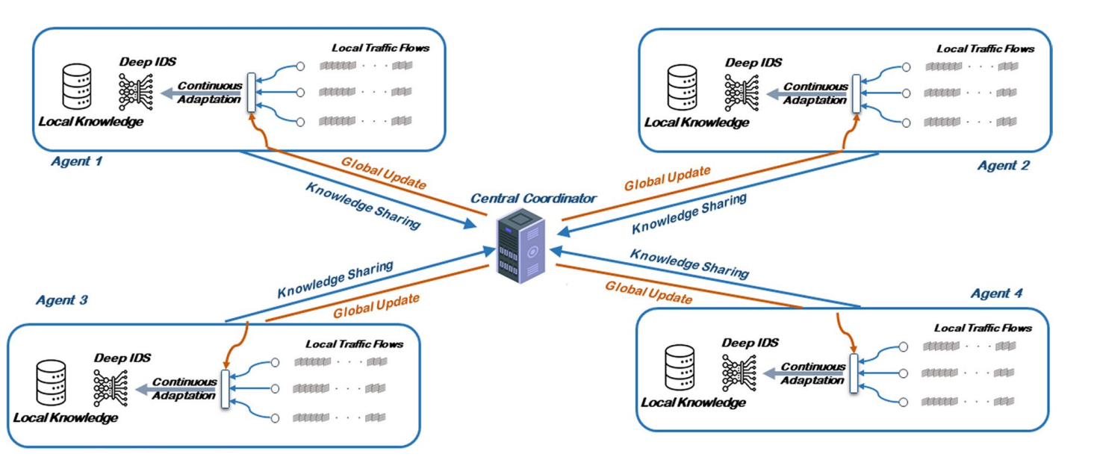
FRAMEWORK OVERVIEW
Multi-Agent System: Utilizes a distributed architecture with multiple agents to monitor network traffic in real-time.

Slide 9
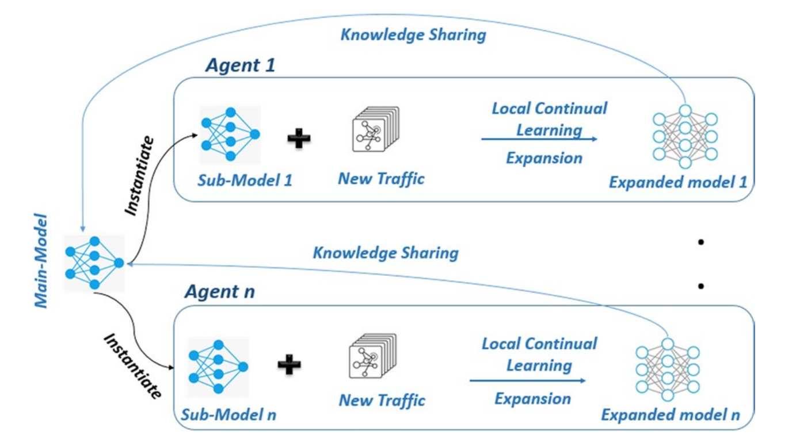
FRAMEWORK OVERVIEW (Contd.)
Deep Learning Integration: Employs continual deep anomaly detectors to adapt to changing attack patterns and benign behavior.

Slide 10
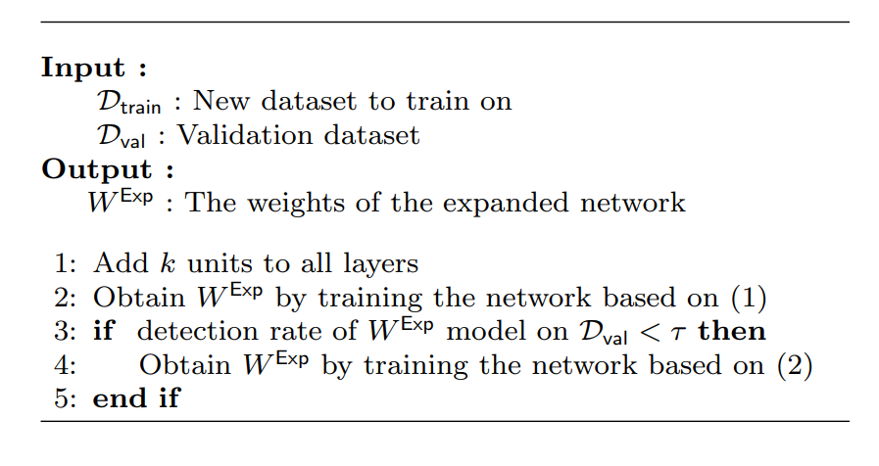
CONTINUAL LEARNING ALGORITHM

Slide 11
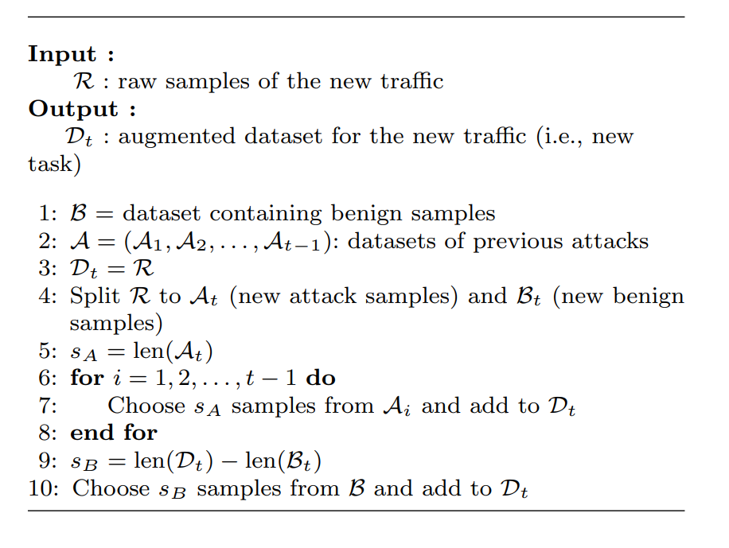
DATA SAMPLING ALGORITHM

Slide 12
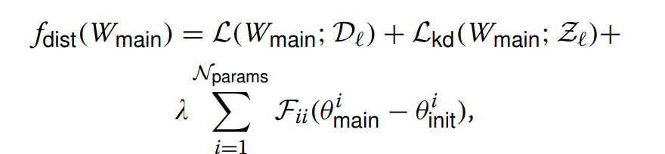
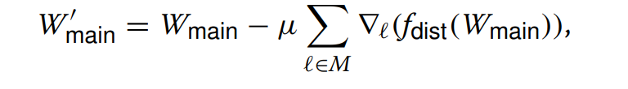

AGENT LEARNING PROCEDURE

Slide 13
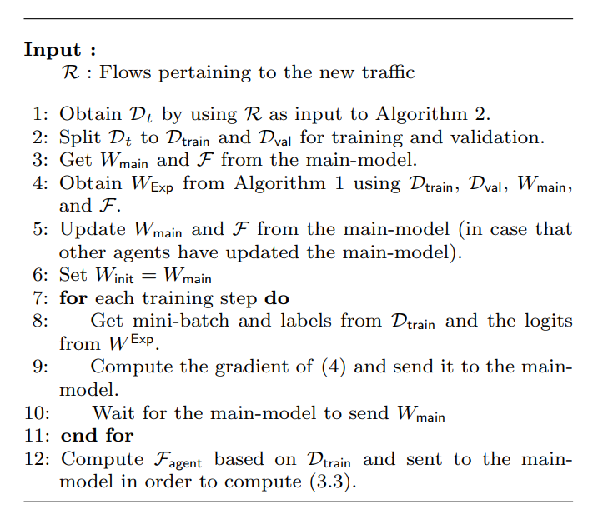
AGENT LEARNING ALGORITHM

Slide 14
2. DATA COLLECTION
DARPA 1999: An older dataset that established baseline attacks.
CIC-IDS2017 and CSE-CIC-IDS2018: More recent datasets that include a variety of attack types such as:
SSH brute force attacks
Denial of Service (DoS) and Distributed Denial of Service (DDoS) attacks
Web attacks (e.g., SQL injection, XSS)
Content-based attacks (e.g., Heartbleed)
Benign profiles are extracted from simulated behaviors of 25 users across several protocols (HTTP, HTTPS, FTP, SSH, and email).
The dataset contains a variety of attack types, including Denial of Service (DoS), Remote-to-Local (R2L), User-to-Root (U2R), and probing attacks.

Slide 15
2. DATA PREPROCESSING
Traffic Flow Extraction:
Raw network traffic is captured in PCAP format.
Flow Matrix Creation:
Input vectors consist of a 20,000-dimensional flow matrix formed from 200-byte packets over 100 packets per flow.

Slide 16
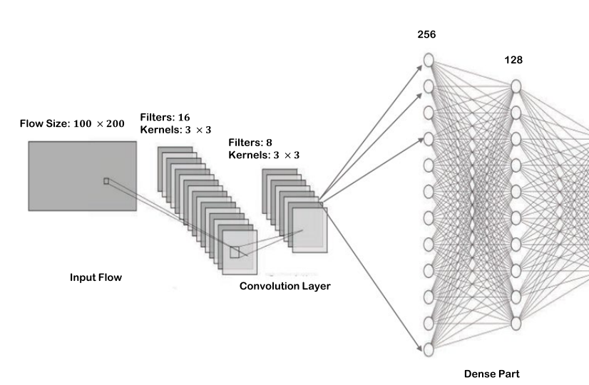
3. ARCHITECTURE
CNN Architecture:
Base Part: Two 2D convolution layers (8 and 16 filters, kernel size 3x3).
Dense Part: Four layers with 256, 128, 64, and 2 neurons.
Input: Entire flow matrix (200 x 100).

Slide 17
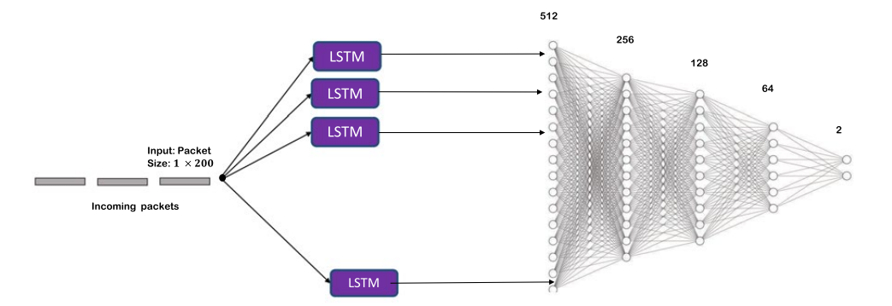
LSTM Architecture:
Base Part: Single many-to-many LSTM layer with 1024 cells.
Dense Part: Five layers with 512, 256, 128, 64, and 2 neurons.
Input: Individual packets (200) fed as a sequence of 100 packets.

Slide 18
4. MODEL TRAINING AND EVALUATION
Data Splitting:
The datasets are divided into three segments to train, validate, and test the models effectively:
64% for training: To build the model and learn patterns.
16% for validation: To fine-tune hyperparameters and prevent overfitting.
20% for testing: To evaluate the model's performance on unseen data

Slide 19
4. MODEL TRAINING AND EVALUATION
Activation Functions:
ReLU used for all layers except the final layer (softmax for output).
Regularization:
Dropout rate of 0.2 applied to mitigate overfitting.
Optimization:
Adam optimizer utilized for efficient training of the models.

Slide 20
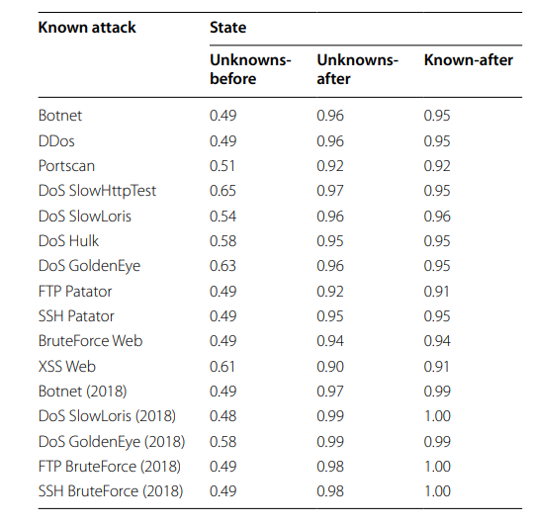
RESULTS
CNN-based model detection rate

Slide 21
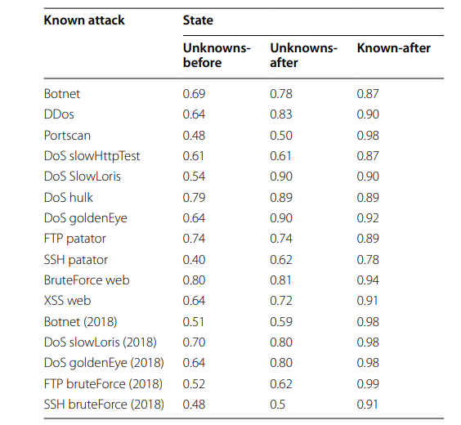
RESULTS(Contd.)
LSTM-based model detection rate

Slide 22
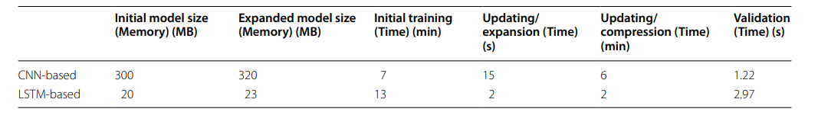
RESULTS (Contd.)
Resource and Time consumption of both models

Slide 23
CONCLUSION AND FUTURE ENHANCEMNT
CNN models outperform LSTM models in learning new traffic patterns due to their ability to extract flow-level features that capture spatial characteristics.
LSTMs excel in detecting anomalies with fewer packets, making them efficient for early detection, but require more effort for initial training.
Both models maintain performance on previously learned anomalies, mitigating the catastrophic forgetting issue.
Investigate the challenges of knowledge sharing between agents in environments with varying statistical and content-based attacks.
Explore the development of unsupervised versions of the proposed framework for broader applicability in real-world scenarios.

Slide 24
REFERENCES
Abadi M et al (2015) TensorFlow: large-scale machine learning on heterogeneous systems. http://tensorfow.org/. Software available from tensorfow. org Abou El Houda Z, Brik B, Khoukhi L (2022) “why should i trust your ids?’’: an explainable deep learning framework for intrusion detection systems in internet of things networks. IEEE Open J Commun Soc 3:1164–1176 Adawadkar AMK, Kulkarni N (2022) Cyber-security and reinforcement learning-a brief survey. Eng Appl Artif Intell 114(105):116
Akhtar N, Mian A (2018) Threat of adversarial attacks on deep learning in computer vision: a survey. IEEE Access 6:14410–14430 Alghamdi R, Bellaiche M (2023) An ensemble deep learning based ids for IoT using lambda architecture. Cybersecurity 6(1):5 Andresini G, Appice A, De Rose L, Malerba D (2021) Gan augmentation to deal with imbalance in imaging-based intrusion detection. Fut Gener Comput Syst 123:108–127

Slide 25
THANK YOU

